Slide 1
Statement of Cash Flows - Accounting Principles
2022. 5.
Yangin Yoon

Slide 2
Agenda
Recap the previous class
Business Cycle and Cash
Three Activities of Cash Flow
Direct Method
Indirect Method

Slide 3
Recap the previous class
Financial Statements
- Statement of Financial Position
- Income Statement
- Statement of Change in Equity
- Statement of Cash Flow

Slide 4
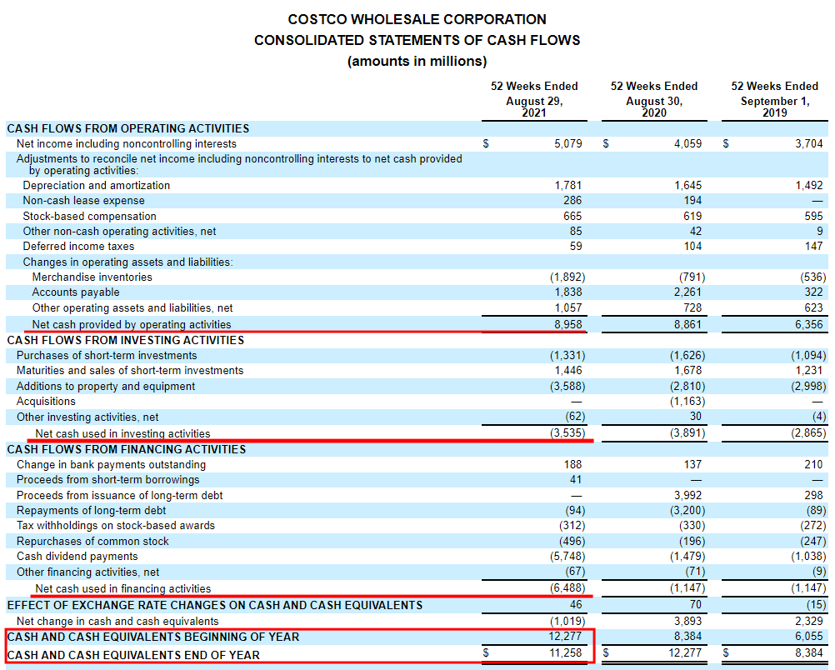
Example of Statement of Cash flow
https://www.sec.gov/Archives/edgar/data/0000909832/000090983221000014/cost-20210829.htm#ie58daa2d8b3247c6bfd8c5ea0ae4a34e_76

Slide 5
Statement of Cash Flow
Business Cycle
Cash Decrease,
Other Assets Increase
Cash
Revenue (Assets Increase),
Expense (Assets Decrease)
Other Assets Decrease,
Cash Increase

Slide 6
Statement of Cash Flow
A Statement of Cash Flow shows the changes of cash during a period.
Beginning balance of cash + Net cash change = Ending balance of cash
“Net cash change” can be divided into three activities:
1) Operating Activities
: Main business activities
2) Investing Activities
: Buying and selling property, plant, and equipment
Buying and selling financial assets
3) Financing Activities
: Borrowing money from banks
Issuing bonds
Issuing stocks

Slide 7
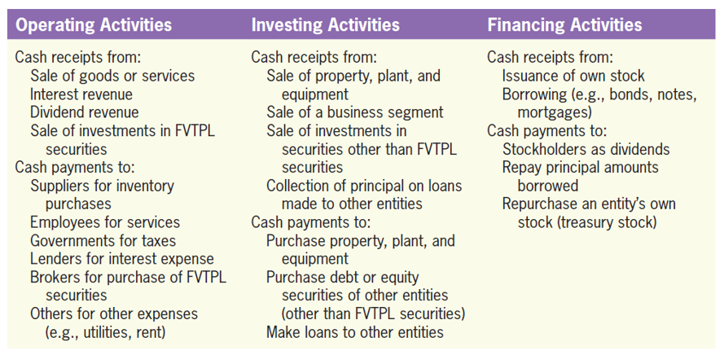
Statement of Cash Flow
© 2017 Cengage Learning, Principles of Financial Accounting, 2/E (IFRS Edition)

Slide 8
Example #1 (Cash Flow)
ST Gas is a gasoline merchandise company. There are following events in 2021. Please prepare a statement of cash flow.
1) ST Gas bought gasoline with $6,000 of cash.
2) It sold gasoline to customers and received $9,000 cash.
3) It sold gasoline of $5,000 to customers on credit.
4) It borrowed $10,000 from a bank.
5) It bought pumping machines by paying $5,000 cash.
6) It sold old machines and received $1,000 cash.
7) It paid $300 cash as interest expense.
8) It gave $600 cash to its shareholders as dividend
9) Salary expense was $2,050, and all was paid by cash.
10) Electricity expense was $500. $400 was paid by cash, and $100 was not paid (it remained as a liability).

Slide 9
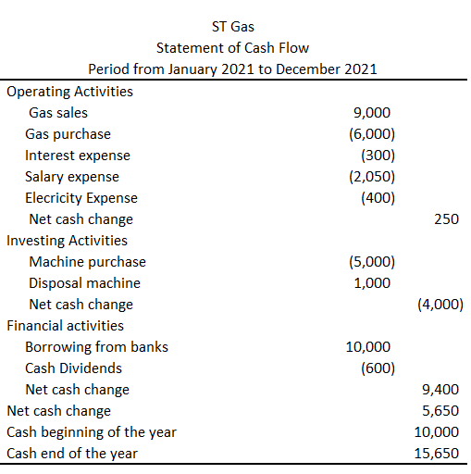
Example #1 (Cash Flow- Direct method)

Slide 10
Two Types of Statement of Cash Flow
Direct Method and Indirect Method
Direct Method
- List all the activities and their cash flow changes.
Indirect Method
- Start from the net-income
- Modifying gain and loss of investing and financial activities
- Modifying operating assets changes
- Modifying operating liabilities changes

Slide 11
Example #2 (Cash Flow)
ST Gas is a gasoline merchandise company. There are following events in 2021. Please prepare a statement of cash flow using indirect method.
1) ST Gas bought pumping machines by paying $5,000.
2) It sold old machines and received $1,000.
(The book value of the machine was $800. So, the disposal gain was $200.)
There is no other transaction.

Slide 12
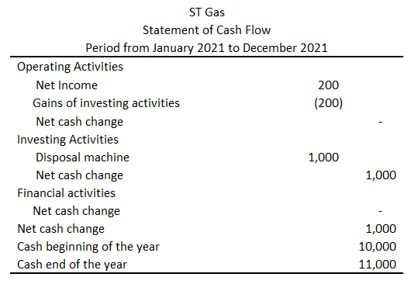
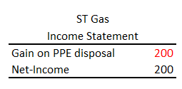
Example #2 (Cash Flow-Indirect method)

Slide 13
Example #3 (Cash Flow)
ST Gas is a gasoline merchandise company. There are following events in 2021. Please prepare the statement of cash flow.
1) ST Gas bought pumping machines by paying $5,000.
2) It sold old machines and received $1,000.
(The book value of the machine was $800. So, the disposal gain was $200.)
3) It sold gasoline of $5,000 to customers on credit.
(The cost of goods was $2,000. It sold the gas which ST Gas had bought in the previous period (2020).)
There is no other transaction.

Slide 14
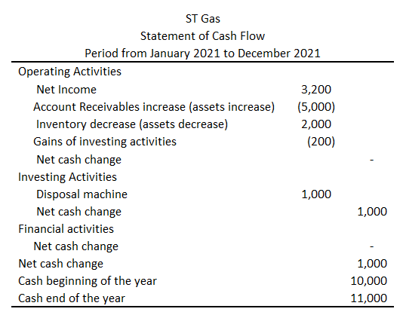
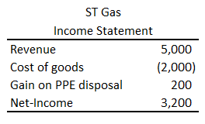
Example #3 (Cash Flow-indirect method)

Slide 15
Example #4 (Cash Flow)
ST Gas is a gasoline merchandise company. There are following events in 2021. Please prepare a statement of cash flow.
1) ST Gas bought pumping machines by paying $5,000.
2) It sold old machines and received $1,000.
(The book value of the machine was $800. So, the disposal gain was $200.)
3) It sold gasoline of $5,000 to customers on credit.
(The cost of goods was $2,000. It sold the gas which ST Gas had bought in the previous period (2020).)
4) ST Gas collected $3,300 of cash from customers.
(Some of accounts receivable were collected.)
There is no other transaction.

Slide 16
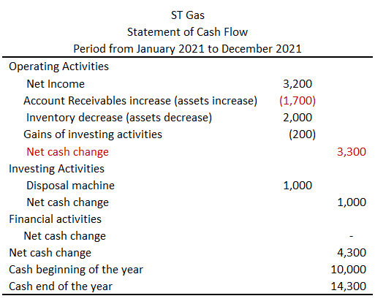
Example #4 (Cash Flow-indirect method)
→ Operating activities’ cash flow was $3,300.

Slide 17
Any Questions?

Slide 18
Example #5 (Cash Flow)
ST Gas is a gasoline merchandise company. There are following events in 2021. Please prepare a statement of cash flow.
1) ST Gas bought gasoline with $6,000 of cash.
2) It sold gasoline to customers and received $9,000 cash. (Cost was $5,000.)
3) It sold gasoline of $5,000 to customers on credit. (Cost was $3,000.)
4) It borrowed $10,000 from a bank.
5) It bought pumping machines by paying $5,000.
6) It sold old machines and received $1,000. (Gain was $200.)
7) It paid $300 cash as interest expense.
8) It gave $600 to its shareholders as dividend
9) Salary expense was $2,050, and all was paid cash.
10) Electricity expense was $500. $400 was paid by cash, and $100 was not paid (it remained as a liability).

Slide 19
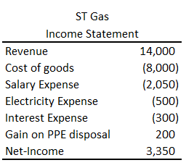
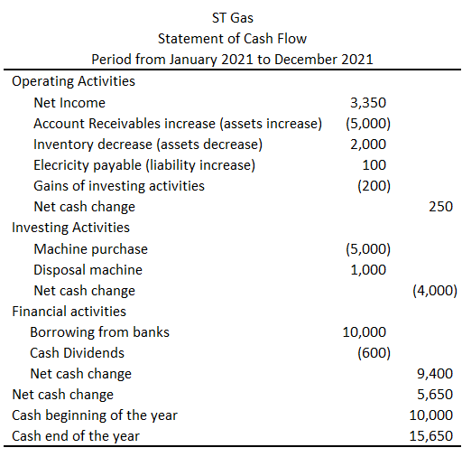
Example #5 (Cash Flow-indirect method)
→ Compare this with Example #1.

Slide 20
Any Questions?

Slide 21
Chapter Summary
Cash Flow Statement
Three components
- Operating, investing, and financing
Direct method
Indirect method

Slide 22
Any Questions?

Slide 23
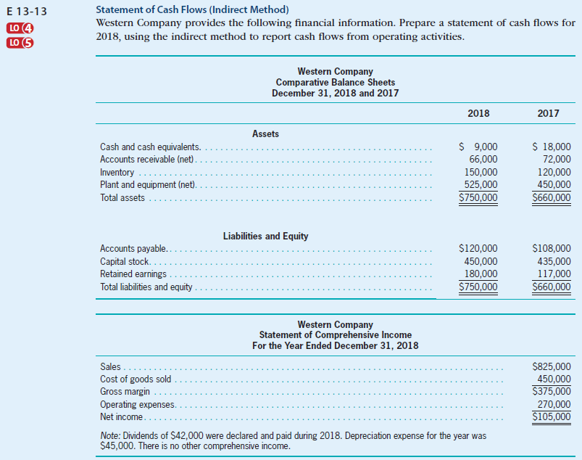
Cash Flow (exercise)
Self-Study Material
© 2017 Cengage Learning, Principles of Financial Accounting, 2/E (IFRS Edition)

Slide 24
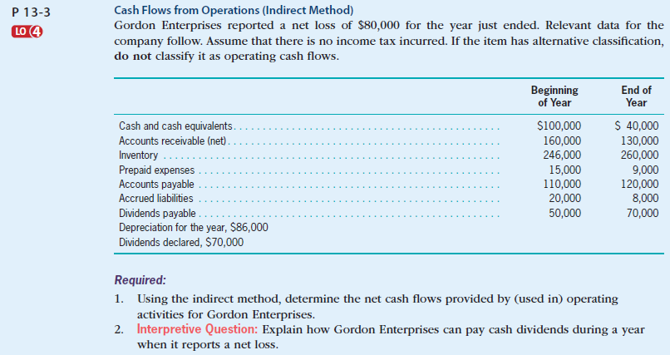
Cash Flow (exercise)
Self-Study Material
© 2017 Cengage Learning, Principles of Financial Accounting, 2/E (IFRS Edition)

Slide 25
Any Questions?

